Slide 1
SMART PROXIMITY
WARNING SYSTEM FOR DEAF DRIVERS
SubMItted by : g.Thanuja
Dep: electronic and communication engineering

Slide 2
INTRODUCTION
Deaf drivers may not hear horns, sirens, or other important sounds on the road. This can make it difficult for them to notice potential dangers. Therefore, a Smart Proximity Warning System for Deaf Drivers using the 8051 Microcontroller is proposed to detect nearby obstacles and provide visual warnings through LEDs.
This project uses an ultrasonic sensor to detect nearby obstacles and an 8051 microcontroller to process the sensor signals. Based on the detected distance, the system is intended to activate visual warning indicators using green, yellow, and red LEDs to represent safe, warning, and danger conditions.
The main aim of this project is to provide a simple and affordable visual warning system that helps deaf drivers become more aware of nearby obstacles. It demonstrates how embedded systems can support people with disabilities and contribute to safer driving.

Slide 3
OBJECTIVES
The main objectives of the Smart Proximity Warning System for Deaf Drivers using the 8051 Microcontroller are:
To detect nearby obstacles using an ultrasonic sensor.
To process the sensor signals using the 8051 microcontroller.
To provide visual warnings through LEDs when obstacles are detected.
To improve obstacle awareness for drivers with hearing impairments
To develop a simple and cost-effective embedded system for road safety
To demonstrate the application of microcontrollers and sensors in assistive technology.

Slide 4
PROPOSED SOLUTION
The proposed system, Smart Proximity Warning System for Deaf Drivers using the 8051 Microcontroller, is designed to detect nearby obstacles and provide visual warnings to drivers with hearing impairments.
The system uses an ultrasonic sensor (HC-SR04) to detect obstacles by transmitting ultrasonic waves and receiving their echoes. The sensor signals are processed by the 8051 microcontroller, which determines the distance to the obstacle using suitable distance-measurement logic.
Based on the measured distance, the microcontroller controls three LEDs to provide visual alerts. The green LED indicates a safe distance, the yellow LED indicates that an obstacle is approaching, and the red LED indicates that an obstacle is dangerously close.

Slide 5

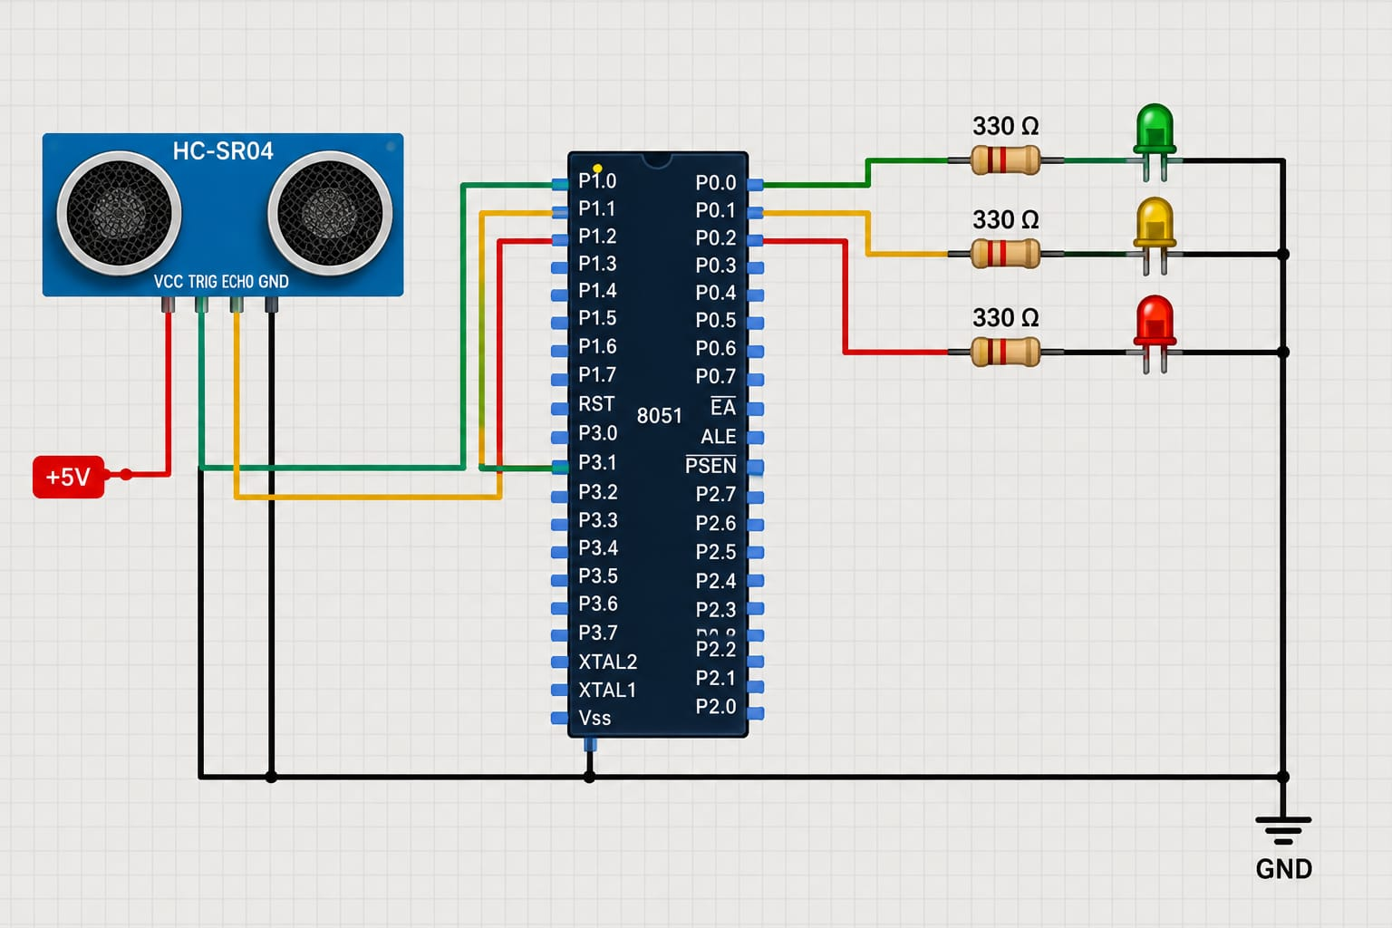
CIRCUIT DIAGRAM

Slide 6
EXPECTED OUTPUT
The Smart Proximity Warning System for Deaf Drivers using the 8051 Microcontroller is expected to detect nearby obstacles using an ultrasonic sensor and provide visual warnings through three LEDs.
The expected outputs are:
Safe Condition: The green LED turns ON when the obstacle is at a safe distance.
Warning Condition: The yellow LED turns ON when the obstacle approaches the warning range.
Danger Condition: The red LED turns ON when the obstacle is very close

Slide 7
CONCLUSION
The Smart Proximity Warning System for Deaf Drivers using the 8051 Microcontroller is a proposed assistive technology designed to improve obstacle awareness and road safety for drivers with hearing impairments. The system uses an ultrasonic sensor to detect nearby obstacles and a microcontroller to process sensor signals. Visual indicators, including green, yellow, and red LEDs, are intended to provide warnings based on the distance of an obstacle. This project demonstrates how embedded systems can be used to develop practical and affordable solutions for people with disabilities. With proper implementation and testing, the system could provide useful visual alerts and help drivers become more aware of nearby obstacles. Further improvements could include more accurate distance measurement, additional warning indicators, and real-world testing to improve reliability.

